Slide 1
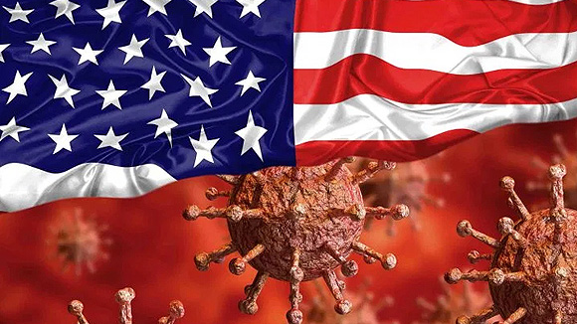
Politics of a Pandemic
Team Members: Cody Tong | Daniel Rossi | Fatima Carrillo | Geoff Farrell | Jackie Huang | William Pryor
Resources: US Count Level Election
NY Times data
US Census
This Photo by Unknown Author is licensed under CC BY-SA-NC

Slide 2
Overview
What influence does the major political party have on the outbreak of Covid 19?
Is there a direct correlation between pollical parties and covid cases by state?
Why does the analysis trend more heavily on one side?
What is the use case of this data?

Slide 3
We utilized three different sources and combined them to do our analysis
Resources:
NY Times article dated 10 “Covid in the U.S. : Latest Map and Case Count
Kaggle for the 2016 Presidential Elections
US Census 2019
We utilized several csv files for each resource and combined them by state and county.
On the NY Times files we utilized the death data, positive / negative total by state
For the Kaggel 2016 Presidential data we used 2016 which was broken down by state and county for those who voted Republican and Democratic
The US Census 2019 population estimates

Slide 4
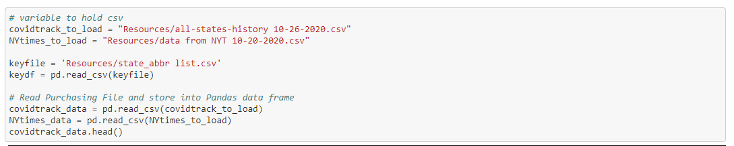
Combining the Covid data portion using our resources
Refined data with a cumulative count of the coronavirus cases in the United States and county level.

Slide 5
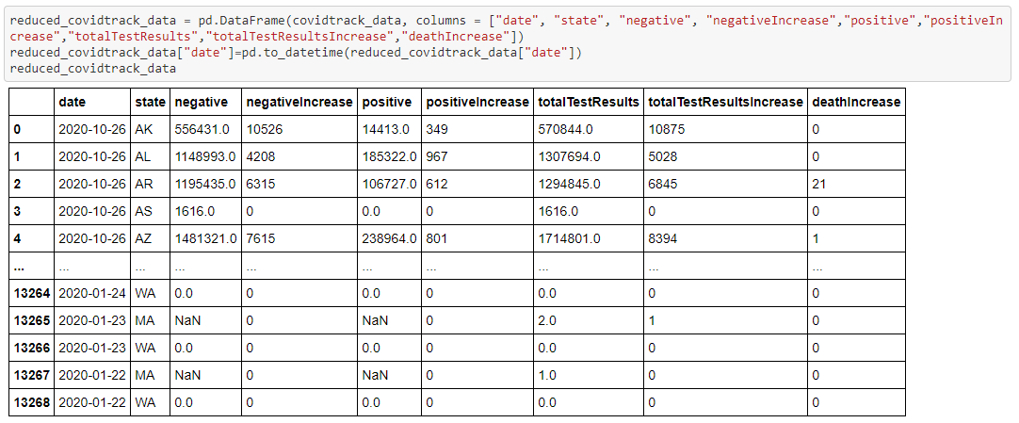

Slide 6
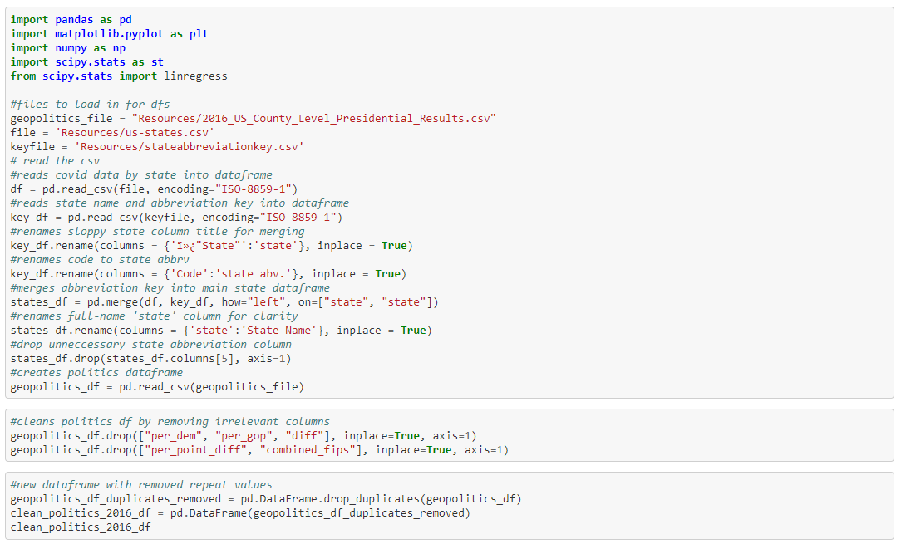
Combining the State / country election 2016 data and the US Census

Slide 7
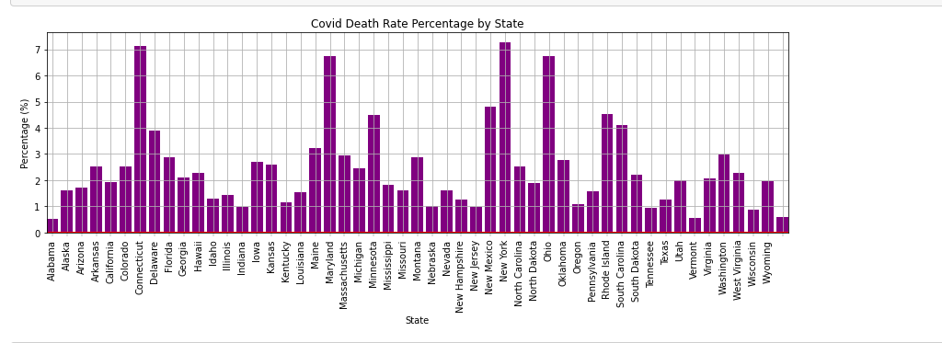

Slide 8
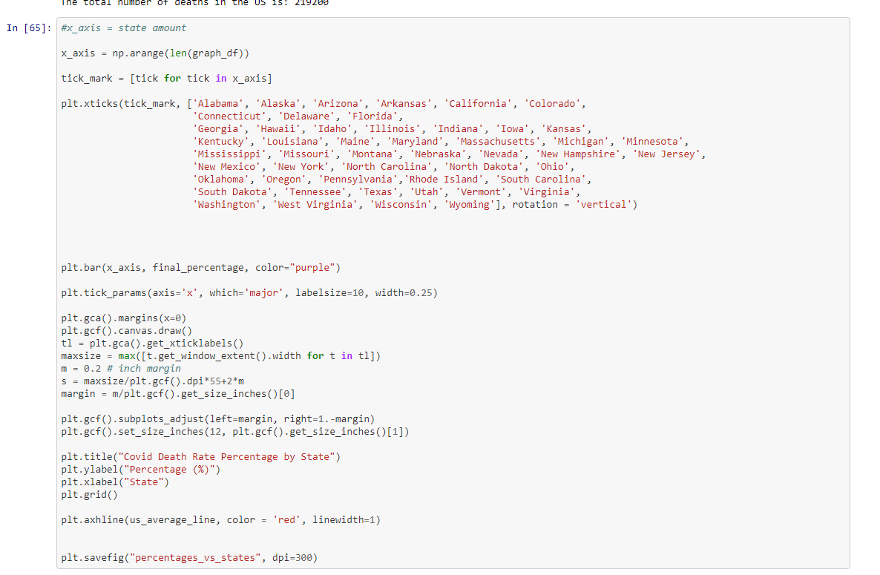
Code for graph

